Slide 1


OBJECT ORIENTED PROGRAMMING THROUGH JAVA

Slide 2

L1 - REVIEW OF OOP CONCEPTS

Slide 3


Slide 4
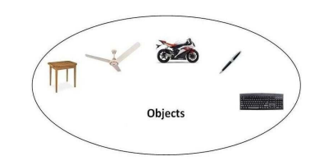
OBJECTS:-
Any entity that has state and behavior is known as an object. For example, a chair, pen, table, keyboard, bike, etc. It can be physical or logical.
An Object can be defined as an instance of a class.
An object contains an address and takes up some space in memory. Objects can communicate without knowing the details of each other's data or code.
The only necessary thing is the type of message accepted and the type of response returned by the objects.
Example: A dog is an object because it has states like color, name, breed, etc. as well as behaviors like wagging the tail, barking, eating, etc.

Slide 5
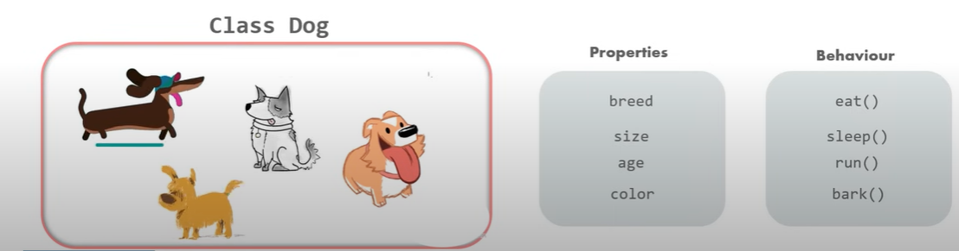
CLASSES:-
Collection of objects is called class. It is a logical entity.
A class can also be defined as a blueprint from which you can create an individual object. Class doesn't consume any space.
The class is one of the Basic concepts of OOPs which is a group of similar entities.

Slide 6
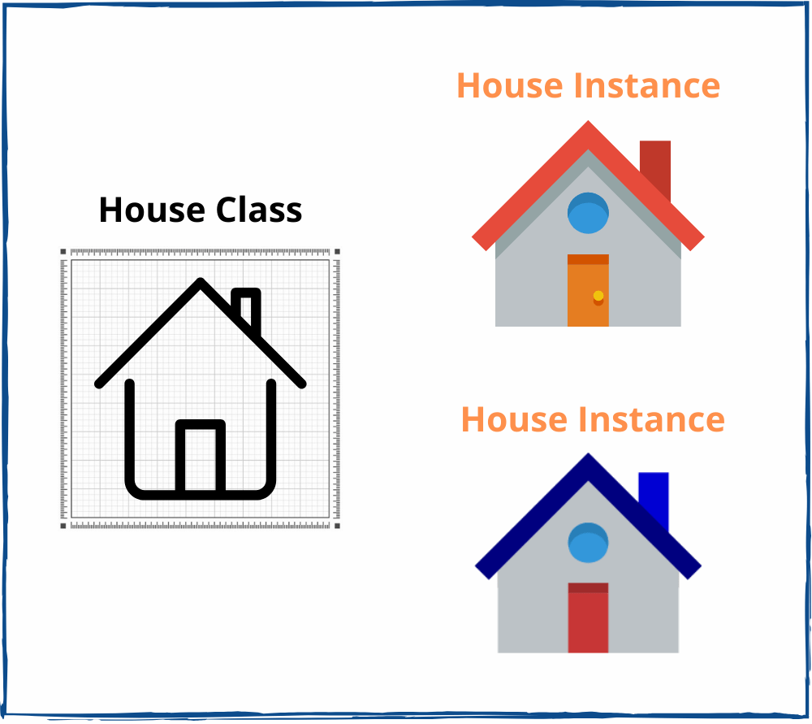

Slide 7
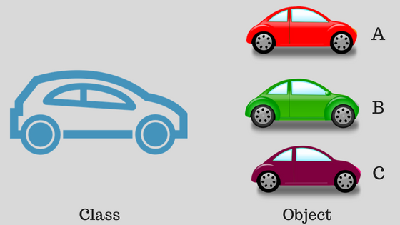

Slide 8
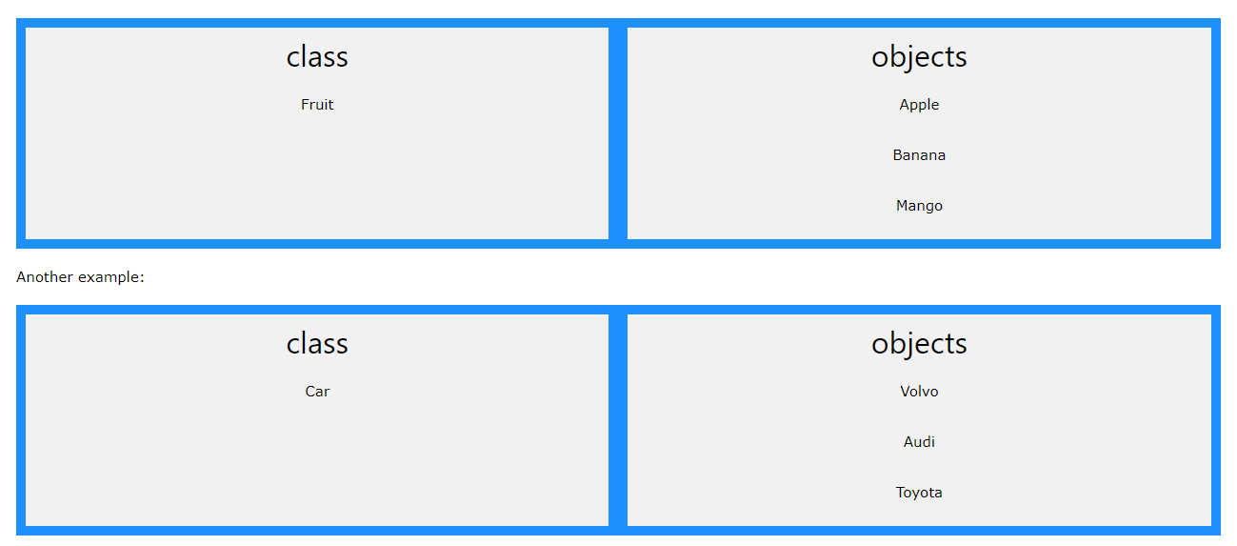

Slide 9
INHERTIANCE:-
Inheritance means inheriting properties. The mechanism by which a class is allowed to derive the properties of a different class is termed inheritance.
With the concept of inheritance, the information in a program can be organized hierarchically.
In simple terms, the inheritance would mean passing down the characteristics of parents(habits, looks, height) to their child.
The most useful contribution of types of inheritance in java would be the reusability of a code.

Slide 10
A few important terminologies associated with the concept are:
Class: It is defined as a group of objects sharing common properties.
Sub Class: Also known as a derived or extended class, this class inherits the features from another class. Also along with the inherited fields and methods, the class generated from the class can add fields and methods of its own.
Super Class: The superclass represents the class whose features are inherited by a sub-class.
Reusability: The technique of reusability allows the user to create a class (a new one) having the fields or methods of an already existing class. It allows reusing the code.

Slide 11
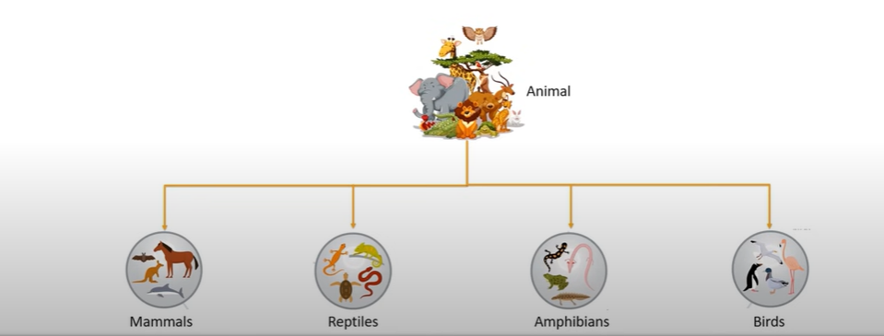
Benefits of Inheritance:-
1. Software reusability (among projects) : Functions written once can be reused. No need to spend time in rewriting the code
2. Code sharing (within a project) : Many users and projects can use the same classes.
3. Increased reliability (resulting from reuse and sharing of well-tested code) : Probability of fewer bugs in already used and tested code.

Slide 12
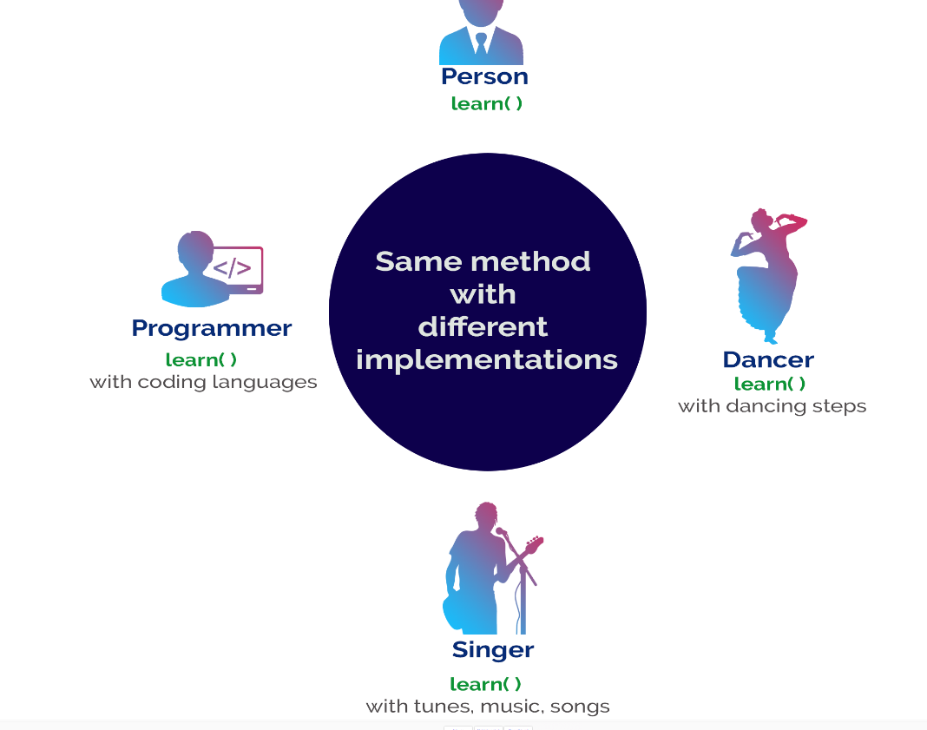
POLYMORPHISM:-
Polymorphism is the process of defining same method with different implementation. That means creating multiple methods with different behaviors.
The java uses method overloading and method overriding to implement polymorphism.

Slide 13
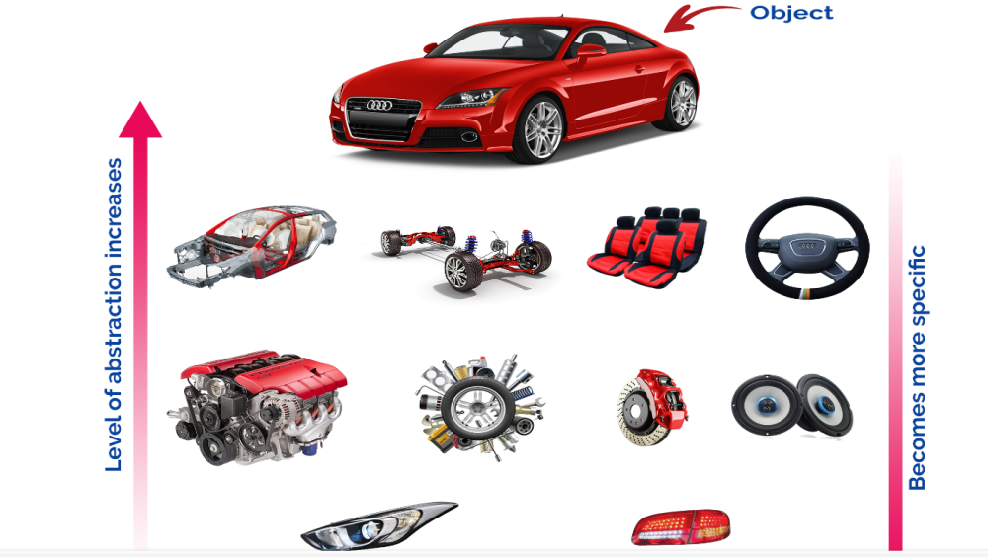
DATA ABSTARCTION:-
Abstraction is hiding the internal details and showing only essential functionality.
In the abstraction concept, we do not show the actual implementation to the end user, instead we provide only essential things.
For example, if we want to drive a car, we does not need to know about the internal functionality like how wheel system works? how brake system works? how music system works? etc.

Slide 14
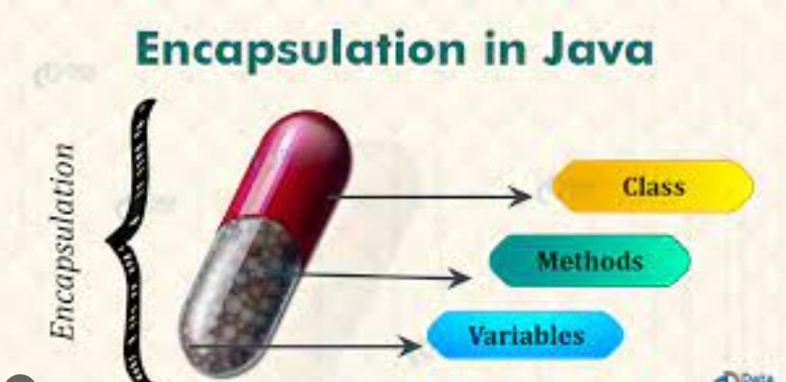
ENCAPSULATION:-
Encapsulation is the process of combining data and code into a single unit (object / class).
In OOP, every object is associated with its data and code. In programming, data is defined as variables and code is defined as methods.
The java programming language uses the class concept to implement encapsulation.

Slide 15
Next….
HISTROY OF JAVA
Notes:
In Slide Show mode, click the arrow to enter the PowerPoint Getting Started Center.

Slide 16



